Slide 1
Effective Fraud Prevention in the Field and Home Office
Presenters:
Doug Leclaire
Ellie Leclaire
Bob Richey

Slide 2
Purpose of Training
Provide an overview of:
  Office of Fraud Prevention and Investigations
  What is Fraud, Waste and Abuse?
  Responsibilities of DAI staff
  Reporting instances of fraud, waste and abuse

Slide 3
Office of Fraud Prevention and Investigations (for Afghanistan Portfolio)
DAI, with USAID’s full support, established the
Office of Fraud Prevention and Investigations
Our mission:
Detect and prevent fraud, waste and abuse in DAI projects in Afghanistan.
Promote education and awareness to prevent instances of fraud, waste and abuse.

Slide 4
Importance of Fraud Prevention
Fraud and corruption is a major concern for DAI and U.S. Government Agencies, including:
    International Contract Corruption Task Force (ICCTF)
    USAID
    Dept. of Justice
    Dept. of Defense
    US Congress
    Office of Inspector General (RIG & SIGAR)

Slide 5
International Contractor Corruption Task Force (ICCTF)
  From 2006 through January 2011
  Charged approximately 143 individuals with fraud
  Recovered more than $161 million
  In 2010 - $47 million restitution in Afghanistan
  Nov. 2010 -- LBG $70 million fine
  Dec. 2010 -- AED suspended by USAID

Slide 6
Fraud, Waste and Abuse
Fraud:
Intentional and Deliberate deception done for individual profit or personal gain or to get an unlawful or unfair advantage
Waste:
Extravagant, careless, or needless expenditure of project funds or services that result in deficient systems, controls, or decisions
Abuse:
Improper, deceptive, or excessive use of the project properties or funds

Slide 7
Common Types of Fraud
Extortion
Bribery
Theft
Abuse of Power
Conflict of
Interest

Slide 8
Common Types of Fraud
Extortion (demand by DAI employee):
Abusing a person’s position or power through intimidation; undue pressure; threats or the exercise of official authority to demand something of value.
-Granting a contract for a “fee” or “something of value”
Abuse of Power:
Using one’s authority to improperly benefit or give undue preferential treatment to anyone or to discriminate against any company or individual.

Slide 9
Common Types of Fraud
Theft – computers, cameras, supplies, vehicles
Bribery (offer to DAI employee):
The promise, offer or giving of anything of value to influence the actions or business decision of an employee.
  A bribe could be paid directly to an employee or indirectly
  to another person, such as a family member.
  A bribe could be money, gift (jewelry, computer), job offer, or anything of value.

Slide 10
Common Types of Fraud
Conflict of Interest:
DAI Employees are prohibited from having an undisclosed interest or ownership in any company seeking business from a DAI project. (Secret ownership)
Employees who are working a second job, must disclose the nature of the work. The second job should not interfere or be in conflict with the DAI employment.
Any potential conflict of interest situation should immediately be disclosed in writing and discussed with your supervisor and/or VP- Human Resources.

Slide 11
Common Types of Fraud
Other Types of Fraud:
    Disclosure of DAI confidential information
    Misrepresentation of identity, credentials or previous employment or salary amount
    Falsifying invoices or expense claims
    Misrepresentation of services or quality of materials
    Salary fraud – false time sheets, ghost staff

Slide 12
Why is Fraud Committed?
“Fraud Triangle”
Consists of three “points”, 99% or more of fraud cases include:
1- Motive – What caused the person to act
2- Opportunity – How was the person able to perform the act
3- Rationale – Justify to themselves that it was okay to do it
MOTIVE
OPPORTUNITY
RATIONALE

Slide 13
Penalties and Outcome (Consequences of Fraudulent Acts)
DAI treats all reports of possible fraud very seriously;
Acts of fraud will not be tolerated and employees or sub-contractors, grantees, vendors who engage in such activities will face serious consequences;
Both DAI staff as well as sub-contractors, grantees, or vendors have a responsibility to ensure that quality work is undertaken and that all US Government funds are used for their intended purposes.

Slide 14

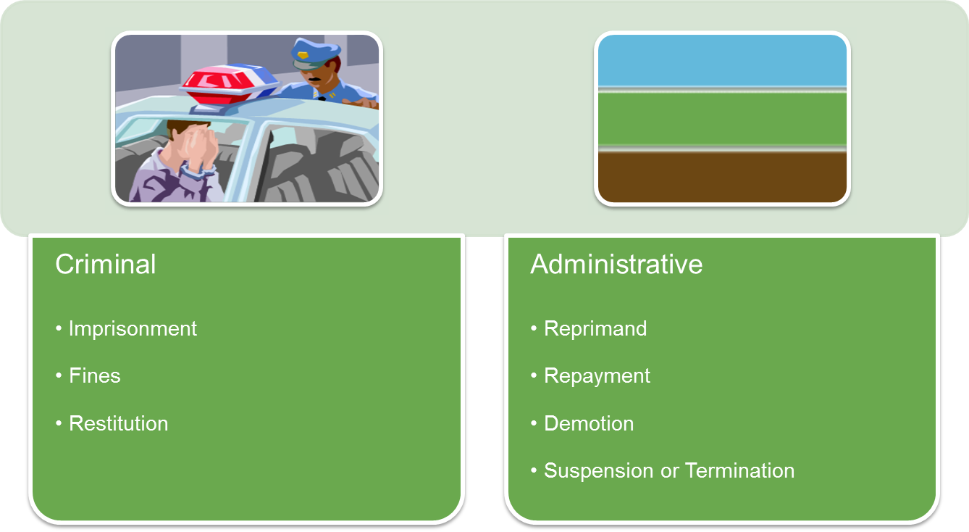
Penalties and Outcomes

Slide 15
Penalties and Outcomes
If an employee is terminated for Fraud, Waste or Abuse, the information could be reported to:
USAID
Office of Inspector General
Other DAI projects
Local authorities for prosecution.
Excluded Parties List System (EPLS)
DAI No Hire List - corrupt or dishonest persons.

Slide 16
Fraud Detection
The most common means of fraud detection is from tips.
Credible tips are typically based on knowledge of the fraudulent act and/or supporting evidence.
Most tips are anonymous, as the reporter (1) does not want to be labeled as a “snitch or whistle blower” or (2) fears retaliation from the fraud perpetrator and/or the employer
Employees and suppliers and vendors, are encouraged to provide tips, anonymously or otherwise.

Slide 17
REPORTING Fraud, Waste or Abuse
DAI staff, subcontractors, grantees and vendors are required to report suspicions of fraud, waste and abuse immediately.
Fraud Prevention and Investigations email Hotline has been established.
  FPI_Hotline@dai.com

Slide 18
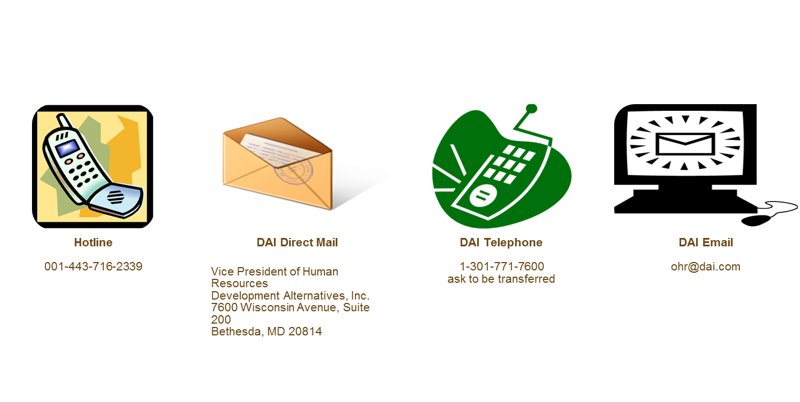
For Anonymous Tips: DAI Hotline
  Please be advised that calling, faxing, and / or submitting email reports may not protect anonymity, depending on the systems used by the reporting party.
  For completely anonymous submission, use the Hotline.
  Don’t use the hotline for personal complaints.
  Those should be handled through established personnel procedures.

Slide 19
Tips when reporting Fraud, Waste or Abuse
Include as much information as possible:
Name and position of the person who committed fraud
Project and/or solicitation number, other identifying information
Date and location where the fraud took place
Exactly what happened
It is important to provide your contact information, phone number or email, for additional information

Slide 20
Implications of Fraud on
Operations & DAI
  Communities will not receive the support that they deserve – Fraud creates a destabilizing impact,
  Innocent and honest staff lose their jobs;
  DAI’s reputation is tarnished – makes it hard for DAI to win contracts;
  Because of the nature of the fraud, staff may have problems finding other work;
  Closer scrutiny by USAID, OIG and other investigative agencies

Slide 21
Challenges to Preventing Fraud in the Field
Difficulty in verifying references
Different cultural views on corruption
Lack of institutional organizations to support transparency
Difficult environment can increase incentives for fraud

Slide 22
How to Overcome Challenges
Fraud prevention measures that are appropriate for every project can includes.
Separation of duties
Conduct Due-Diligence
Undertake periodic audits
Hold trainings on fraud prevention
Policies, Practices and Procedures Guides
Checklists
Work in support of OIG to manage risk

Slide 23
Fraud Awareness Training
REMEMBER –
Your assistance will make a difference and help prevent fraud, waste & abuse.
Your effort will enable all of us to benefit, both now and in the future.
Thank You!
Questions?

